Slide 1
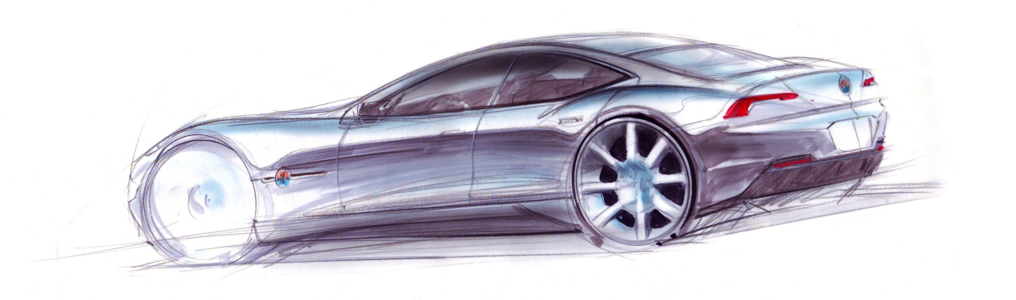
JS UI & DOM TEAM WORK
TEAM MONKEY GLAND CAR RACER

Slide 2
JS UI & DOM TEAM WORK
TEAM MONKEY GLAND CAR RACER
LIST OF MEMBERS
o decho.D - Дечо Дечев
o nikola.stefanov - Никола Стефанов
o dobromira.boycheva - Добромира Бойчева
o petya.mechkova - Петя Мечкова
o NEw358 - Калоян Маршалов
o iliant - Илияна Антова
o Arhigram - Георги Петров

Slide 3
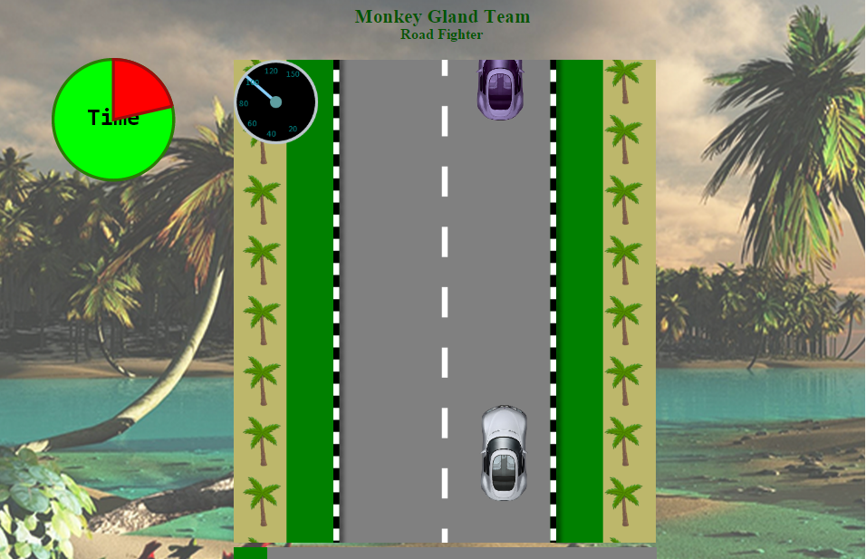
Don’t hit enemy cars within the given time.
If you hit enemy car the game ends.
Time is tracked by a clock and progress is measured by a progress bar.
The game ends if the player hits enemy car, time runs out or the player presses the escape button.
Speed is measured and displayed.

Slide 4
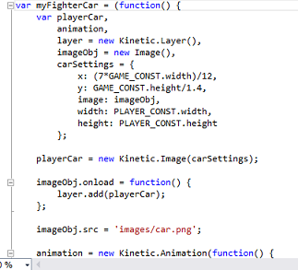
JS UI & DOM TEAM WORK
TEAM MONKEY GLAND CAR RACER
REQUIREMENTS FULFILLED:
• Use the HTML5 canvas
• A Canvas framework - KineticJS
• Use SVG
• Create animations
• The application works in the latest versions of the browsers

Slide 5
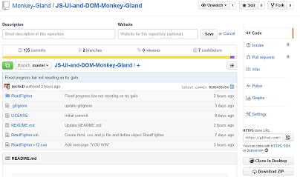
JS UI & DOM TEAM WORK
TEAM MONKEY GLAND CAR RACER
ADDITIONAL REQUIREMENTS:
Follow the best practices for producing high-quality code:
• Correct naming
• Data encapsulation
• Use OOP and modules
• Strong cohesion
• Loose coupling
• Use GIT

Slide 6
JS UI & DOM TEAM WORK
TEAM MONKEY GLAND CAR RACER
LIVE DEMO

